Slide 1


HOTBYTE - Food ordering application
Team members:
Nipurna Bandi
2. Siddhi Kasbekar
Mentor:
Javeed Mohammed Husnuddin

Slide 2

Introduction
1.Problem Statement:
To develop a state-of-the-art full stack web application for online food ordering.The goal is to provide customers with a seamless and user-friendly platform for ordering food online, enhancing their overall dining experience.
2.Technologies and platforms used:
-Frontend: Angular, Html, css,Bootstrap
-Backend: Spring boot
-Database: MySql
Authentication: JSON Web Tokens (JWT) for secure user authentication
-Source code management(SCM): Git
-Code quality check : sonarlint
-IDE : STS, VScode

Slide 3


3. Scope:
1. User Registration and Authentication: Allow users to register, log in, and securely manage their accounts.
2. Menu Management: Restaurant staff/admin manage menu listings, track menu, and update menu availability. menu with detailed item descriptions, prices, and images. Implement menu categorization for breakfast, lunch, and dinner, Appetizer, Main Course, Dessert, burger, pizza, Italian, Arabian etc items.
3. Efficient Order Placement: Develop user-friendly interface for customers to place food orders efficiently and should be notified by email.
4. Cart Management: Enable users to add, remove, and manage items in their carts before checkout.
5. Order Tracking: Customers can login anytime and check the status of their order.
6. Restaurant Management: Restaurant can add menu and fix the discount price for the menu.
Restaurant can view the orders, update the order status:

Slide 4
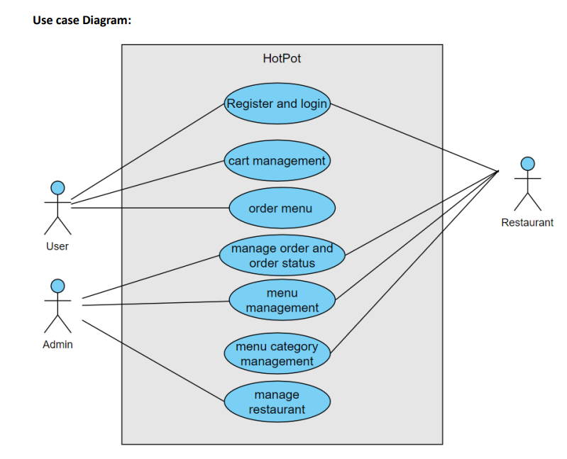

Slide 5

Modules
Admin Dashboard-role(admin):
Use Case: Log In.
Use Case: Add / Remove Restaurant, discount, manager
Use Case: view customers, restaurant, discounts ,managers
2. Manager Dashboard-role(manager):
Use Case: Log In.
Use Case: Add / Remove menu items, menu category.
Use Case: view all orders, menu items, menu categories
Use Case: update order status

Slide 6


3. Customer Dashboard-role(customer):
Use Case: User Registration and login.
Use Case: Restaurant browsing and menu Browsing.
Use Case: Cart Management.
Use Case: Checkout and Payment.
Use Case: View orders history.

Slide 7
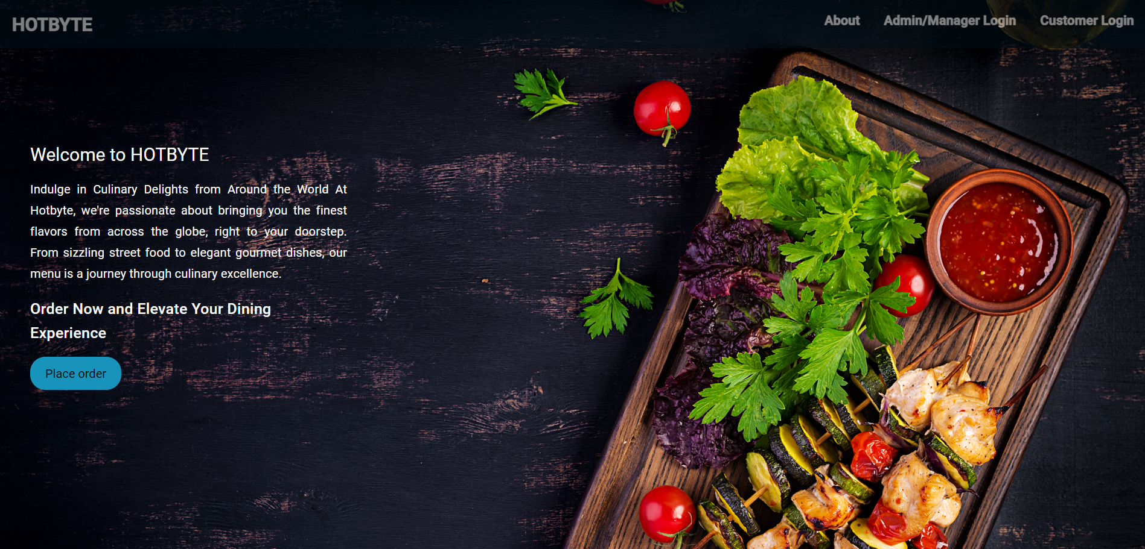
Landing Page

Slide 8
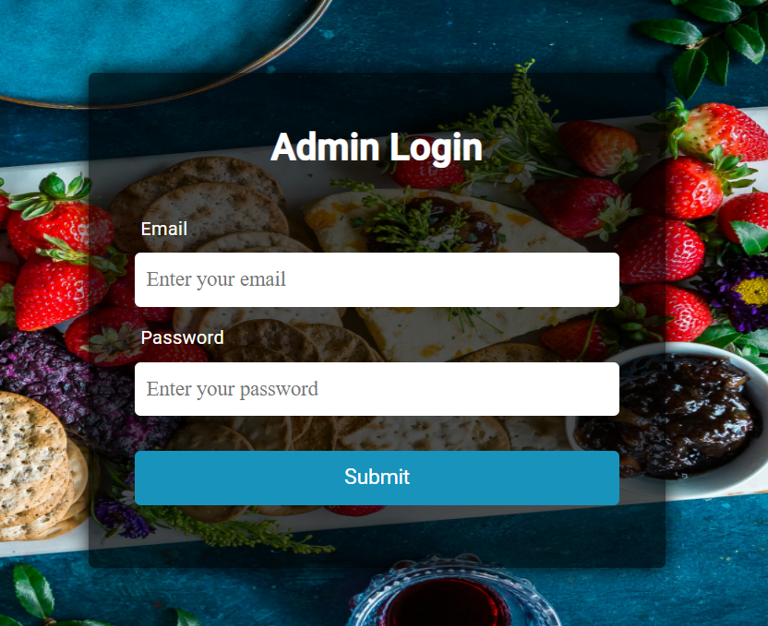
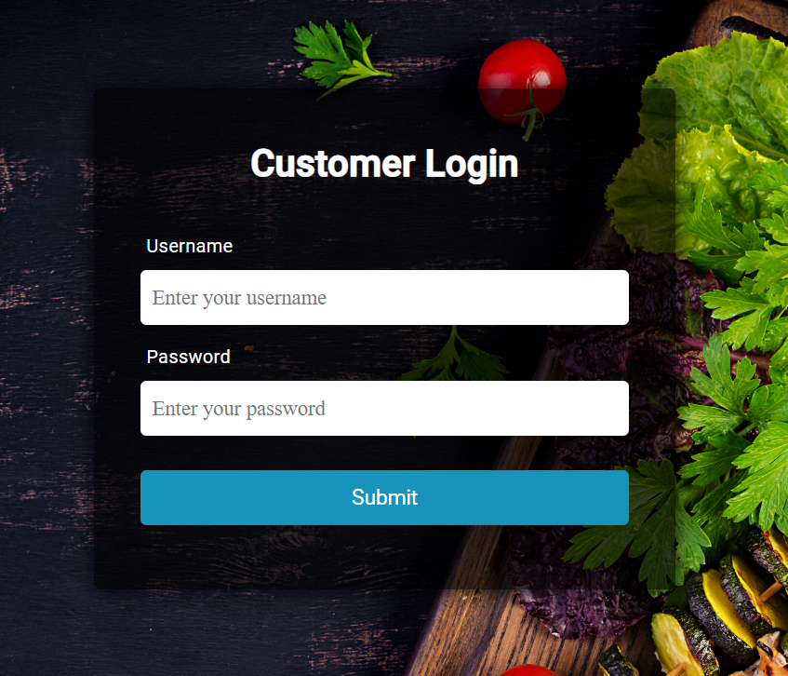
Login pages

Slide 9
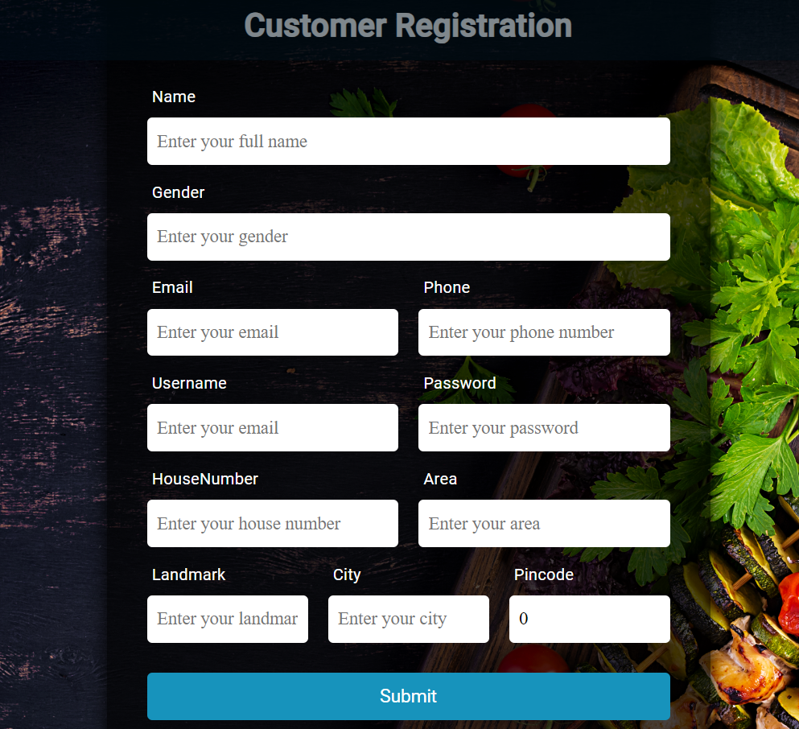
Customer registration form

Slide 10
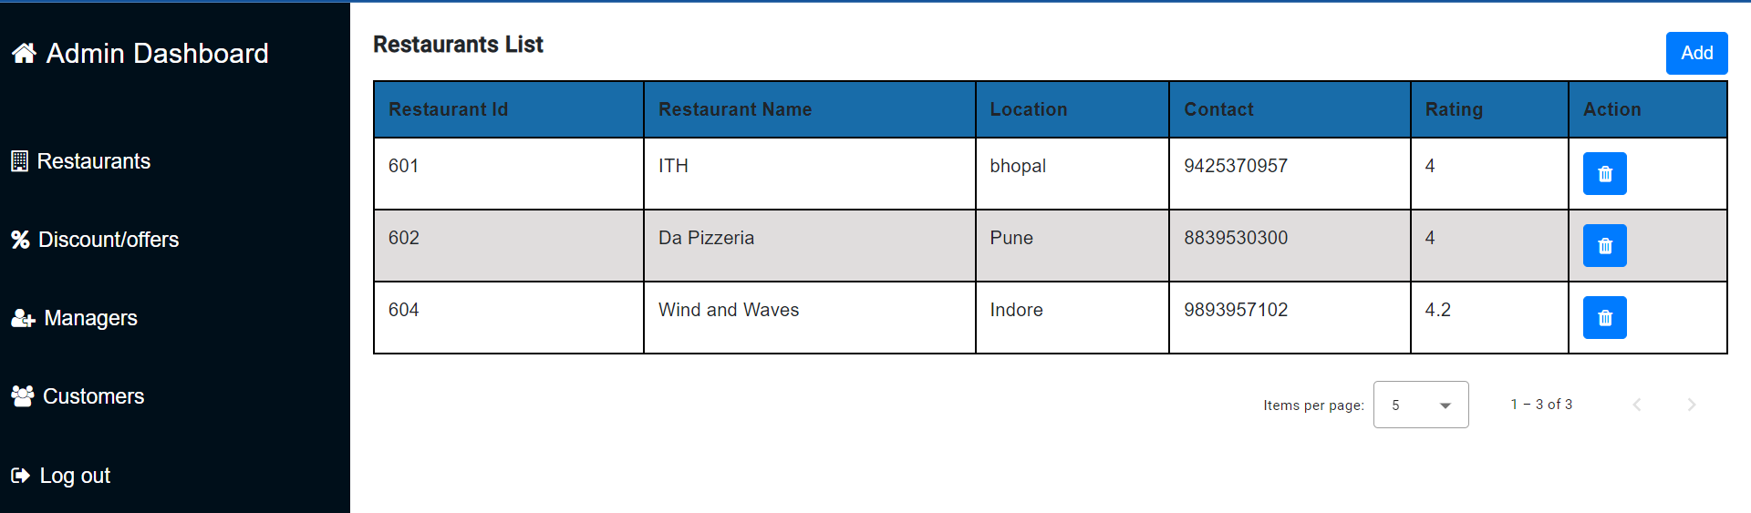
Restaurants list

Slide 11
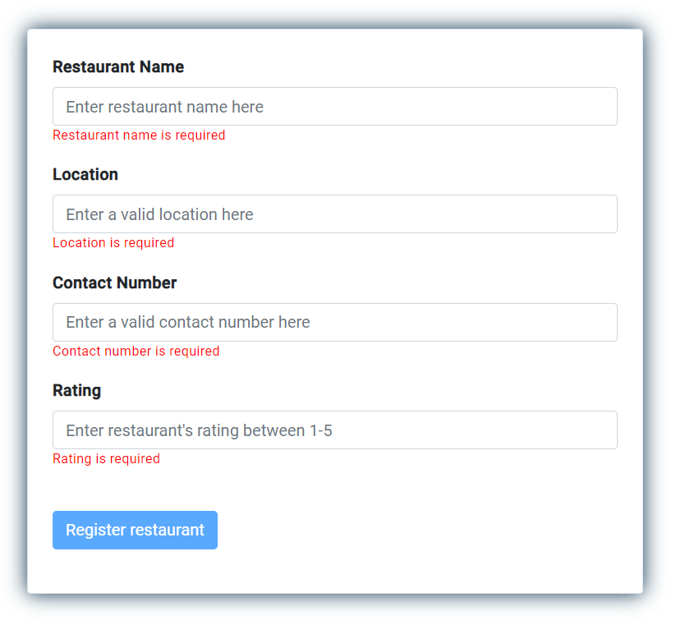
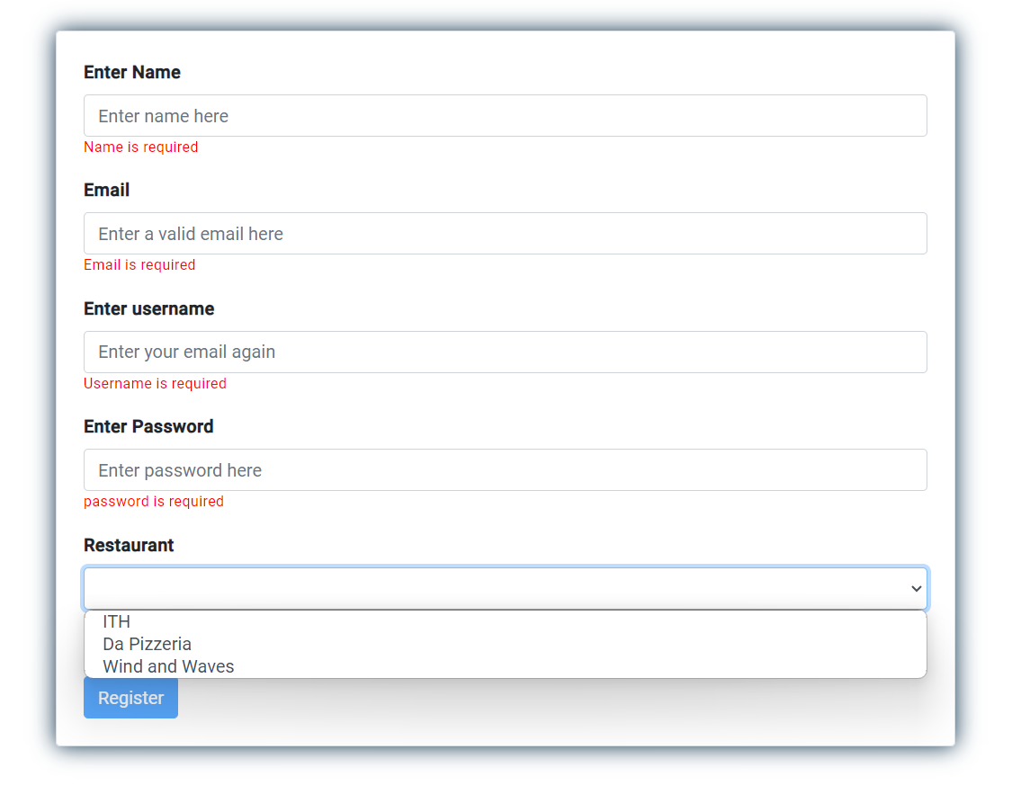
Register restaurant form Register Manager form

Slide 12
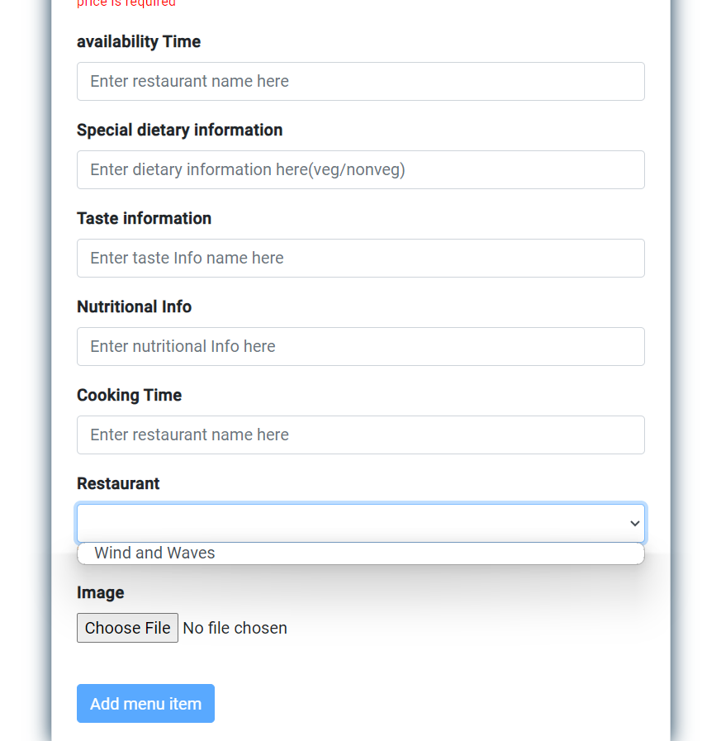
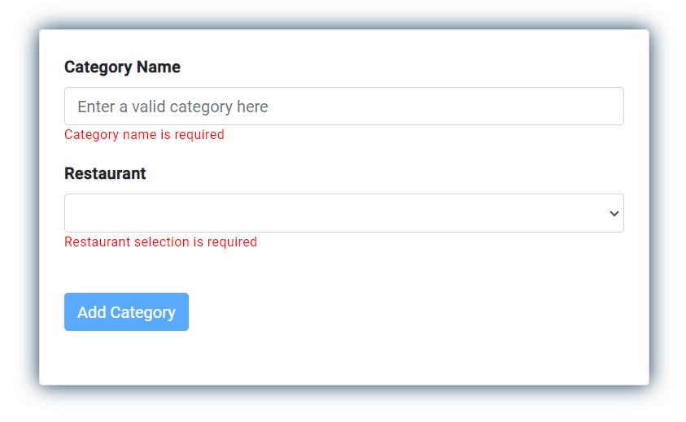
Add menu item form Add category form

Slide 13
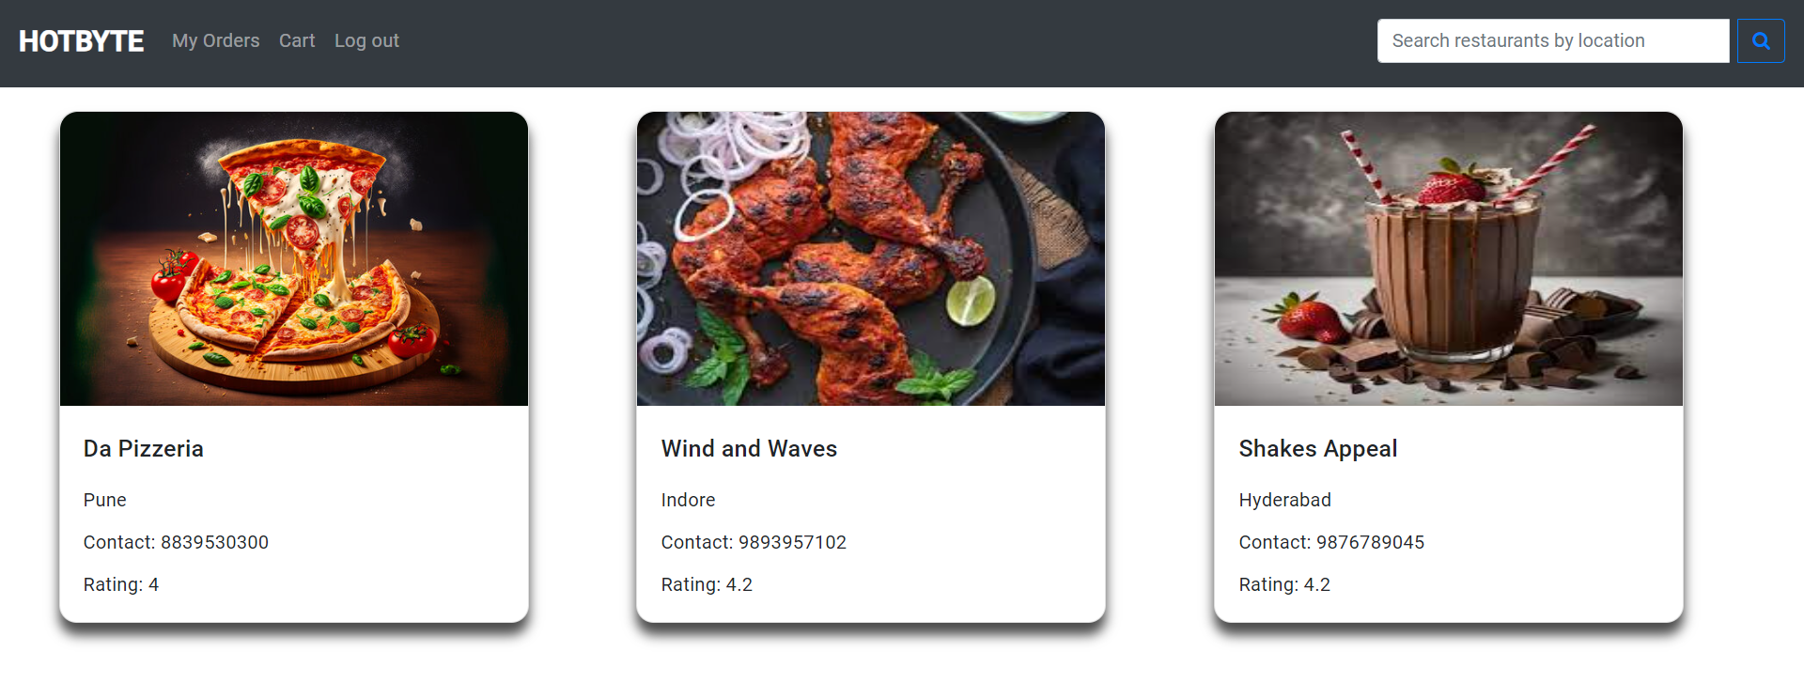
Customer Dashboard

Slide 14
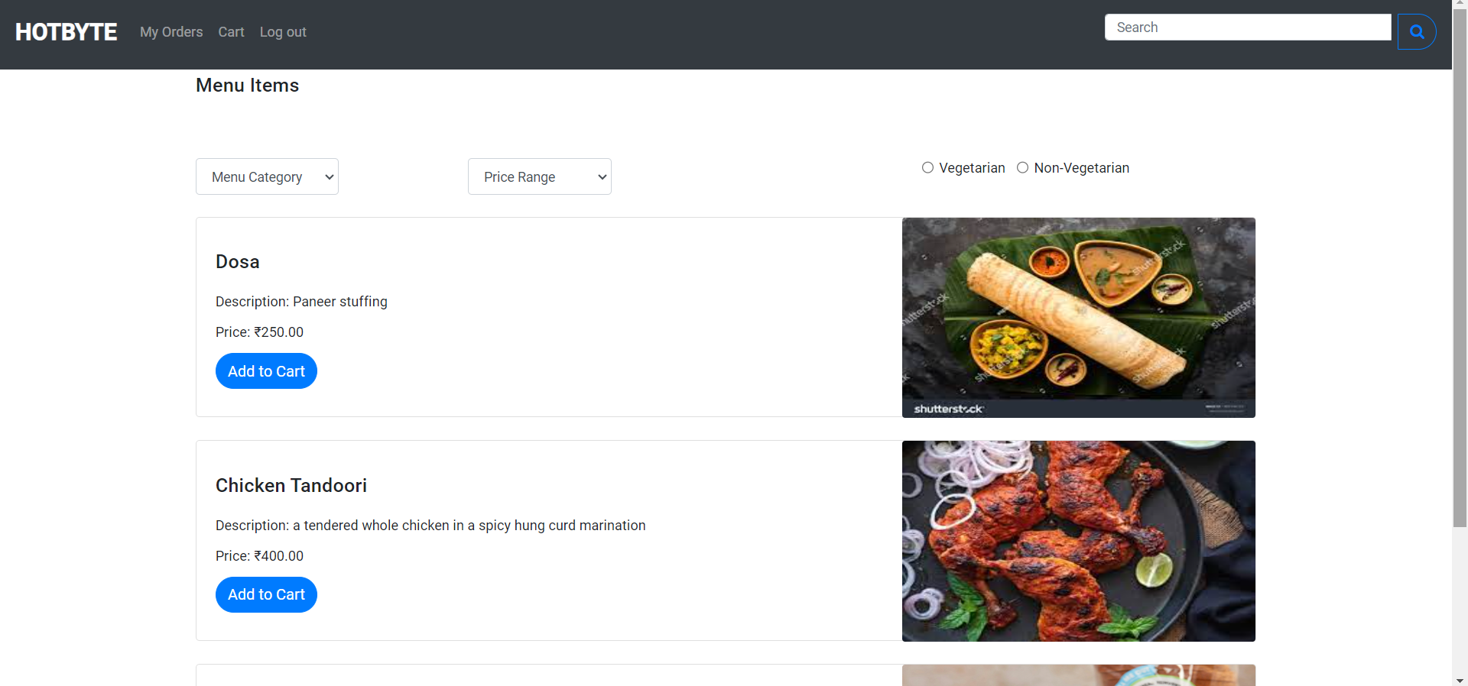
Restaurants menu list with filters

Slide 15
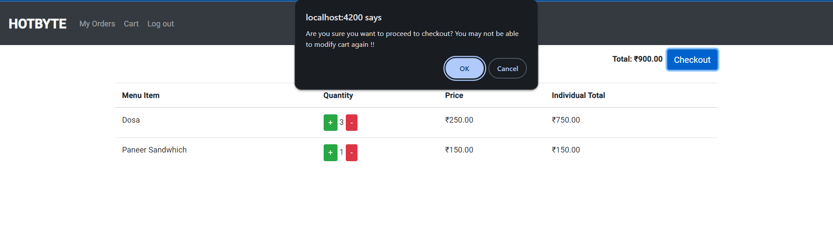
Customer cart

Slide 16
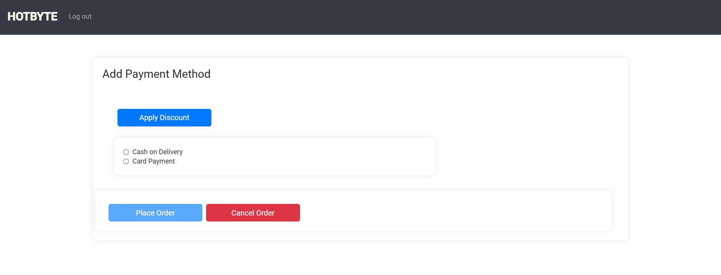
Checkout page

Slide 17
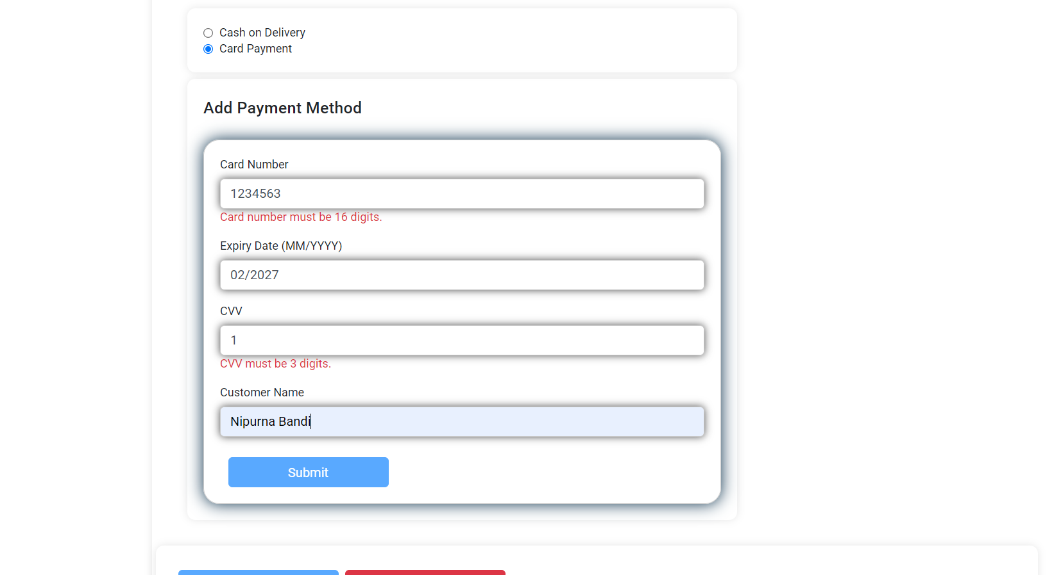
Card Payment

Slide 18
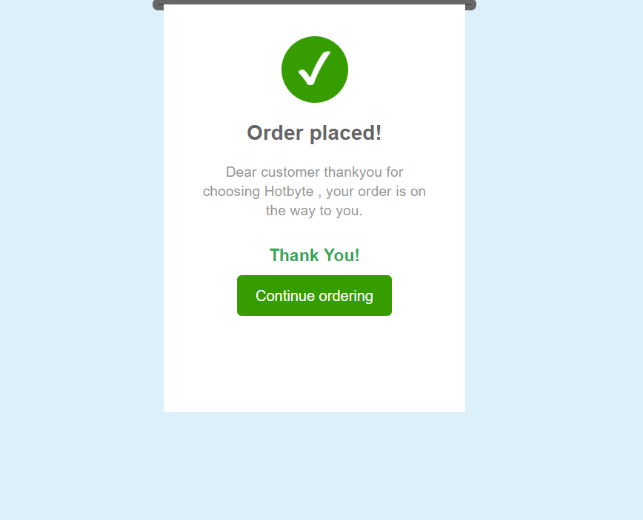
Order placed

Slide 19
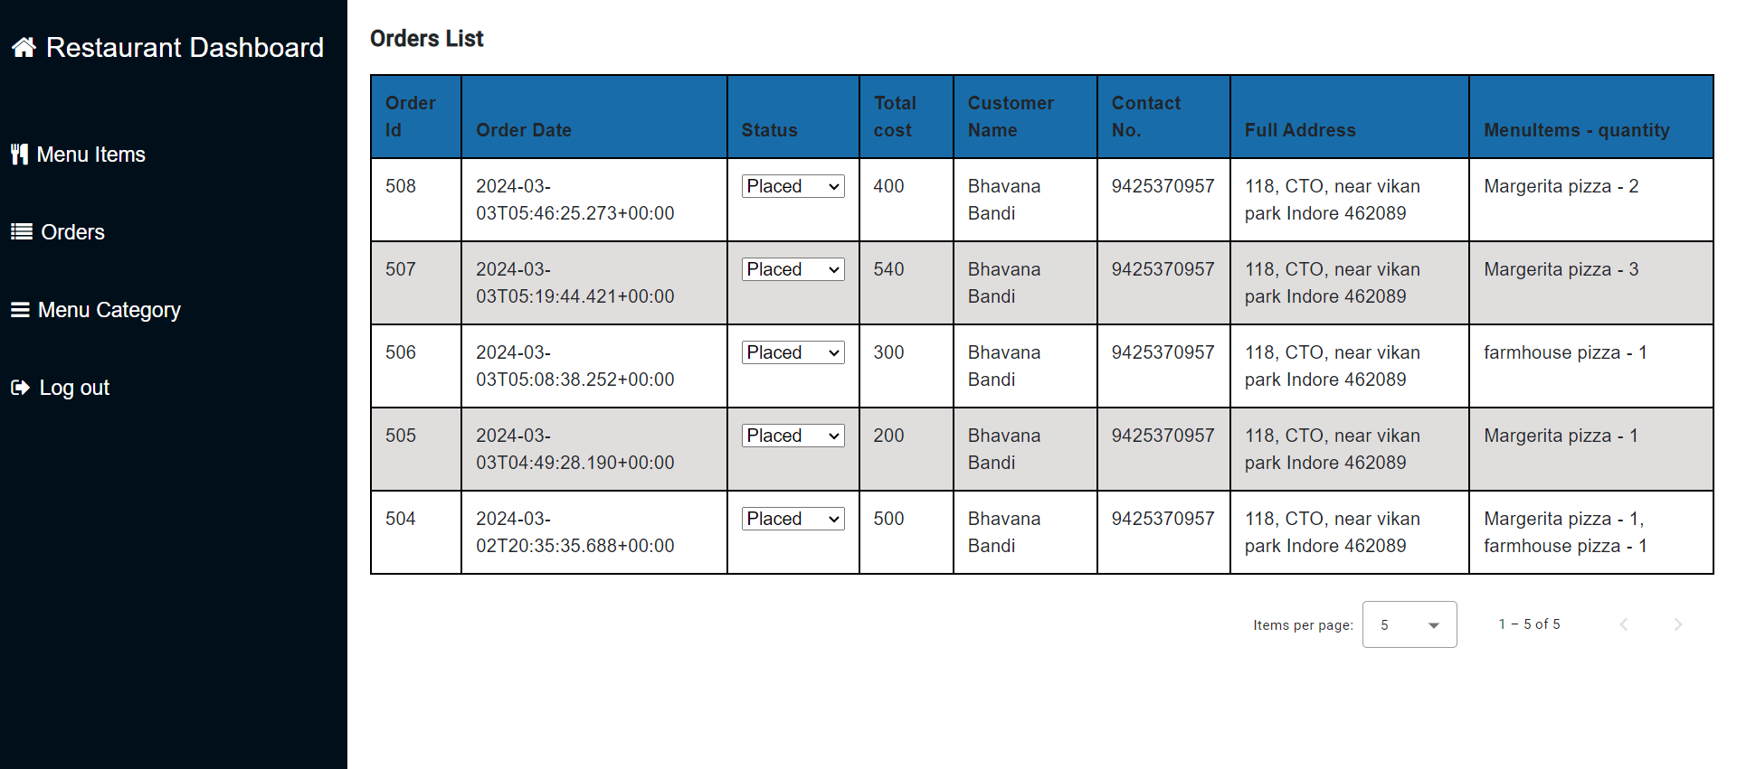
Orders list

Slide 20
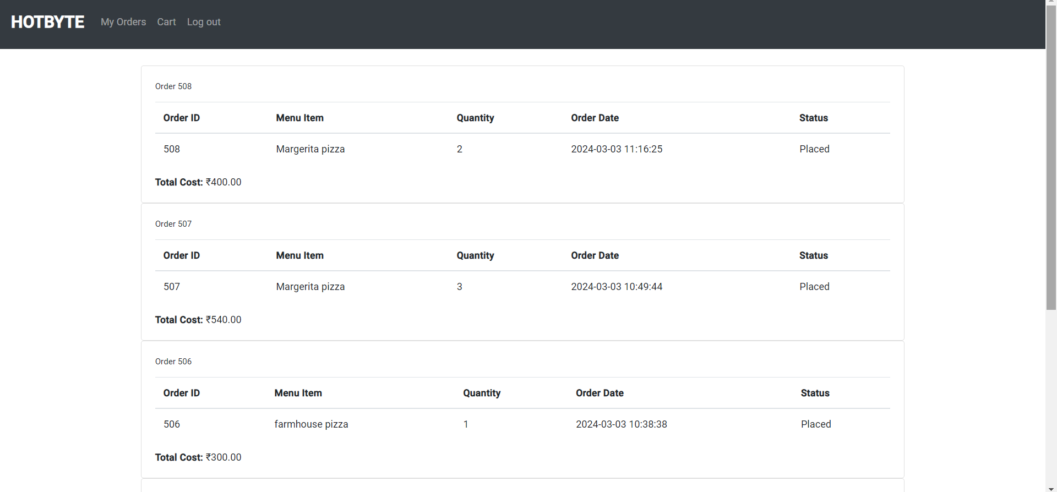
Order history

